Slide 1

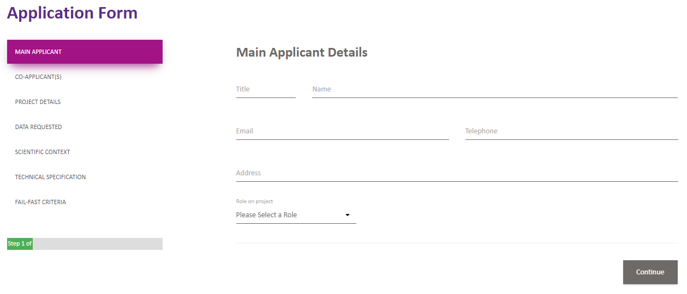
Writing a good proposal

Slide 2
Applicants
Who can assist you with your project?
This includes collaborators who can assist you with different aspects of your project throughout the project lifecycle.
This is not always apparent in the beginning, attempt to think forward, e.g., statisticians; knowledge mentors; project manager
Think beyond your own institution, collaborative projects look good on grant applications in the future and may contribute an additional aspect to your work

Slide 3
Public Benefit
Think about why you are doing this project and the benefits to the general public and wider audience.
Start initially with the question in your mind ‘why am I doing this?’
Who will this benefit?
Why will it benefit them?
How does it build on what is already known?
Can it impact at policy level?
Are there ways to engage the public in my research or research findings?

Slide 4
Data Requested
Be specific but not restrictive
Try to avoid applying for ALL data, because 1. you risk having your application rejected 2. you will end up with more data than you know what to do with 3. thinking about what data you need focuses your question.
Use the Data Discovery tools to identify the appropriate cohorts which will enable you to answer your research question.
Use the Data Discovery tools to further identify the variables to guide data application. Use journal papers and online dictionaries where information is not detailed adequately, or contact a member of the DPUK team.
Apply for appropriate data according to your research question, i.e., avoid applying for genetic data if you are not researching a genetic question. This will avoid the risk of having your proposal rejected on the grounds of discrediting you as a researcher.

Slide 5
Scientific Context
Study overview
Summarize your proposal for a layperson to understand.
Avoid the use of scientific or subject specific advanced terminology, if possible.
Write out acronyms.
As this is an overview, the use of references could be left for the scientific rationale section.
Ask someone out of your subject area to read your study overview and see if they understand what your study is about…if they do not, you might need to rewrite this section.

Slide 6
Scientific Rationale
Background to your proposal
This is your literature review where it is expected that you will make use of references to justify your study.
Here you could provide a brief background whilst also mentioning how your own work contributes to existing work.
Use of scientific and technical terminology is acceptable but acronyms should be written out where they have not already been written out in previous sections.
Finish the section with a clear objective, aim and research question.

Slide 7
Analysis Plan
Appropriate to answer research question
Extreme detail is not required
A clear understanding of the required analyses is required, i.e., for a longitudinal research question, longitudinal statistical methodologies are expected.
Display progression of analytical thought rather than a random list of statistical methodologies.
Avoid stating the use of advanced statistical procedures that you know you have no intention using or have no experience with unless you are listing a statistician as a collaborator (in which case, state this somewhere in your proposal).

Slide 8
Ethical approval
Please do not leave blank
Your application will be returned if you leave this section blank
Ethical approval is already in place for primary cohort data collection, you are applying to conduct secondary data analysis on these data, therefore, it is good to state this and display awareness of ethical procedures.
If you are applying for recontact studies, additional ethical procedures will apply, please see our recontact policy.

Slide 9
Keywords
Please do not leave this blank
Decide on keywords which define your research.
These will be utilised to guide researchers to search across proposals in later development of our visibility tools.
This is good practice as this is required in all grant proposals.
This is required for all publications.
Most cohort owners will appreciate this.

Slide 10
Fail-fast criteria
Read and check the boxes
These have been created as a quick check guide to ensure a high quality completion of the application form.
This is also chance for the cohort owners to swiftly accept or reject a project proposal.
It is important therefore, to use this opportunity to think about your application at this stage and recheck each section and question whether each section adequately conforms to the criteria.

